Slide 1

Distributed System
Naming
Rochedi Adha

Slide 2
Objektif
Memahami dan menjelaskan fungsi sistem penamaan dalam mengidentifikasi dan mengakses entitas di sistem terdistribusi.
Menguraikan konsep flat naming dan mengidentifikasi tantangan dalam menentukan lokasi entitas yang terkait.
Menjelaskan bagaimana structured naming memungkinkan pencarian entitas secara efisien melalui organisasi nama yang hierarkis.
Mengidentifikasi prinsip attribute-based naming dan tantangan dalam mengaitkan atribut dengan entitas tertentu.

Slide 3
Lingkup Bahasan
Sistem penamaan dalam sistem terdistribusi
Flat naming
Structured naming
Atribute-based naming
Kesimpulan

Slide 4
Lingkup Bahasan
Sistem penamaan dalam sistem terdistribusi
Flat naming
Structured naming
Atribute-based naming
Kesimpulan

Slide 5
Naming
Nama (naming) dalam sistem terdistribusi adalah representasi berupa deretan bit atau karakter yang digunakan untuk merujuk ke entitas tertentu.
Entitas ini dapat berupa sumber daya seperti host, printer, file, atau entitas lain seperti proses, pengguna, atau bahkan halaman web​

Slide 6
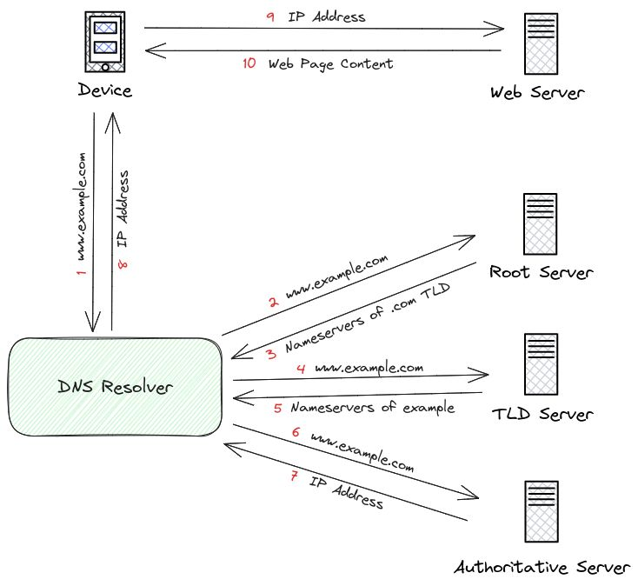
DNS

Slide 7
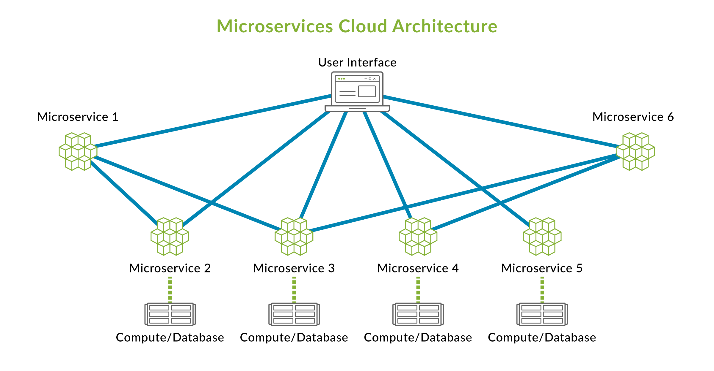
Microservice

Slide 8

Microservices Explained in 5 Minutes
Source: https://www.youtube.com/watch?v=lL_j7ilk7rc

Slide 9
Lingkup Bahasan
Sistem penamaan dalam sistem terdistribusi
Flat naming
Structured naming
Atribute-based naming
Kesimpulan

Slide 10
Flat Naming
Flat naming adalah sistem penamaan di mana entitas diidentifikasi menggunakan nama atau pengenal tanpa struktur hierarkis, sehingga tidak ada informasi tentang lokasi atau organisasi entitas yang terkandung dalam nama itu sendiri.
Dalam flat naming, diperlukan mekanisme khusus seperti forwarding pointers atau distributed hash tables (DHT) untuk menemukan dan mengakses entitas tersebut karena nama tidak memberikan petunjuk lokasi.

Slide 11
Broadcasting
Broadcast the ID, requesting the entity to return its current address
Can never scale beyond local-area networks
Requires all processes to listen to incoming location requests
Address Resolution Protocol (ARP)
To find out which MAC address is associated with an IP address, broadcast the query “who has this IP address”?

Slide 12
Forwarding pointers
Forwarding pointers adalah salah satu metode untuk menemukan entitas yang bergerak dalam sistem terdistribusi.
Konsep ini bekerja dengan meninggalkan pointer atau referensi di lokasi lama saat entitas berpindah ke lokasi baru.
Setiap kali entitas berpindah, lokasi sebelumnya menyimpan informasi atau rujukan ke lokasi baru, sehingga memungkinkan pencarian entitas dengan mengikuti rantai forwarding pointers dari lokasi awal ke lokasi terkini

Slide 13
Prinsip Dasar: Ketika sebuah entitas pindah dari lokasi A ke lokasi B, lokasi A akan menyimpan pointer yang merujuk ke lokasi B. Dengan cara ini, setiap kali ada permintaan untuk mengakses entitas tersebut, permintaan akan mengikuti rantai pointer dari lokasi lama ke lokasi baru. Keuntungan:
Sederhana
Proses pencarian entitas dapat dilakukan tanpa perlu sistem penamaan yang rumit, cukup dengan mengikuti rantai pointer
Kelemahan:
Rantai terlalu panjang
Rentan terhadap kegagalan
Kinerja menurun
Notes:
Keuntungan:
Sederhana dalam implementasi karena hanya memerlukan penyimpanan referensi di lokasi sebelumnya.
Proses pencarian entitas dapat dilakukan tanpa perlu sistem penamaan yang rumit, cukup dengan mengikuti rantai pointer​(Naming).
Kelemahan:
Rantai terlalu panjang: Jika entitas sering berpindah, rantai forwarding pointers bisa menjadi terlalu panjang, yang membuat pencarian entitas menjadi tidak efisien.
Rentan terhadap kegagalan: Jika ada pointer yang hilang atau rusak di dalam rantai, pencarian entitas bisa gagal.
Kinerja menurun: Semakin panjang rantai, semakin besar kemungkinan masalah kinerja, terutama jika ada banyak pointer yang harus diikuti​(Naming)​(Naming).

Slide 14

Example: SSP chains
The principle of forwarding pointers using
(client stub, server stub)
Process P2
Stub cs* refers to same server stub as stub cs.
Client stub cs*
Process P3
Identical client stub
_{Process P1} Server stub
Client stub cs
Process P4
Object
Local invocation
Interprocess communication
Identical server stub

Slide 15

Example: SSP chains Redirecting a forwarding pointer by storing a shortcut in a client stub
Invocation request is sent to object
Server stub is no longer referenced by any client stub
Server stub at object's current process returns the current location
(a)
Client stub sets a shortcut
(b)

Slide 16
Home-based approaches
Home-based approach adalah metode untuk melacak entitas bergerak dalam sistem terdistribusi dengan menetapkan satu lokasi tetap yang disebut "home" atau lokasi rumah, yang selalu menyimpan informasi tentang lokasi entitas saat ini.
Setiap kali entitas bergerak, informasi mengenai lokasi barunya diperbarui di lokasi rumah tersebut, sehingga setiap permintaan untuk mengakses entitas bisa diarahkan terlebih dahulu ke home, yang kemudian mengarahkan ke lokasi saat ini

Slide 17



The principle of mobile IP
Host's home location
1. Send packet to host at its home
2. Return address of current location
Client's location
3. Tunnel packet to current location
4. Send successive packets to current location
Host's current location

Slide 18
Naming: Flat naming
Home-based approaches
Home-based approaches
Problems with home-based approaches
Home address has to be supported for entity’s lifetime
Home address is fixed ⇒ unnecessary burden when the entity
permanently moves
Poor geographical scalability (entity may be next to client)
Note
Permanent moves may be tackled with another level of naming (DNS)

Slide 19
Naming: Flat naming
Distributed hash tables
Illustrative: Chord
Consider the organization of many nodes into a logical ring
Each node is assigned a random m-bit identifier.
Every entity is assigned a unique m-bit key.
Entity with key k falls under jurisdiction of node with smallest
id ≥ k (called its successor succ(k )).
Nonsolution
Let each node keep track of its neighbor and start linear search along the ring.
Notation
We will speak of node p as the node have identifier p
General mechanism

Slide 20
Naming: Flat naming
Distributed hash tables
Chord finger tables
Principle
Each node p maintains a finger table FT_{p} [] with at most m entries:
FT_{p} [i ] = succ(p + 2^{i−1})
Note: the i -th entry points to the first node succeeding p by at least 2^{i−1}.
To look up a key k , node p forwards the request to node with index j satisfying
q = FT_{p} [j ] ≤ k < FT_{p} [j + 1]
If p < k < FT_{p} [1], the request is also forwarded to FT_{p} [1]
General mechanism
12 / 46

Slide 21
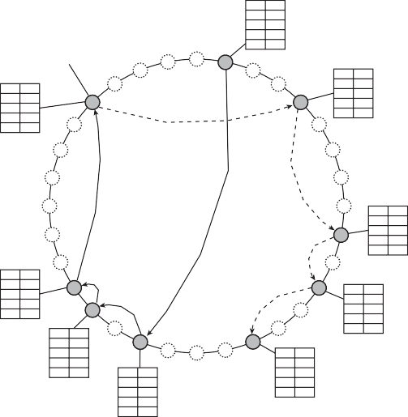
Chord lookup example
Naming: Flat naming Distributed hash tables
Resolving key 26 from node 1 and key 12 from node 28
¹ ⁴ Finger table
2 4
3 9
4 9
5 18
Actual node
succ(p + 2^{i-1} )
0
i
1 9
2 9
3 9
4 14
5 20
31 1
30 2
1 1
2 1
3 1
4 4
5 14
29
3
28
4
27
Resolve k = 12 from node 28
5
26
6
25
7
24
8
1 11
2 11
3 14
4 18
5 28
23
Resolve k = 26 from node 1
9
22
10
1 28
2 28
3 28
4 1
5 9
21
11
1 14
2 14
3 18
4 20
5 28
20
12
1 21
2 28
3 28
4 28
5 4
19
13
18
17
16
15
14
1 18
2 18
3 18
4 28
5 1
1 20
2 20
3 28
4 28
5 4
General mechanism

Slide 22
Naming: Flat naming
Distributed hash tables
Chord in Python
1 class ChordNode:
2 def finger(self, i):
3 succ = (self.nodeID + pow(2, i-1)) % self.MAXPROC
4 lwbi = self.nodeSet.index(self.nodeID)
5 upbi = (lwbi + 1) % len(self.nodeSet)
6
7
8
9
10
11 def recomputeFingerTable(self):
12 self.FT[0] = self.nodeSet[self.nodeSet.index(self.nodeID)-1] # Pred.
13 self.FT[1:] = [self.finger(i) for i in range(1,self.nBits+1)] # Succ.
14
15 def localSuccNode(self, key):
16 if self.inbetween(key, self.FT[0]+1, self.nodeID+1): # in (FT[0],self]
17
18
19
20
21
22
# succ(p+2ˆ(i-1)) # self in nodeset # next neighbor
for k in range(len(self.nodeSet)): # process segments
if self.inbetween(succ, self.nodeSet[lwbi]+1, self.nodeSet[upbi]+1):
return self.nodeSet[upbi] # found successor
(lwbi,upbi) = (upbi, (upbi+1) % len(self.nodeSet)) # next segment
return self.nodeID # responsible node
elif self.inbetween(key, self.nodeID+1, self.FT[1]): # in (self,FT[1]]
return self.FT[1] # succ. responsible
for i in range(1, self.nBits+1): # rest of FT
if self.inbetween(key, self.FT[i], self.FT[(i+1) % self.nBits + 1]):
return self.FT[i] # in [FT[i],FT[i+1])
General mechanism

Slide 23
Exploiting network proximity
Naming: Flat naming Distributed hash tables
Problem
The logical organization of nodes in the overlay may lead to erratic message transfers in the underlying Internet: node p and node succ(p + 1) may be very far apart.
Solutions
Topology-aware node assignment: When assigning an ID to a node, make sure that nodes close in the ID space are also close in the network. Can be very difficult.
Proximity routing: Maintain more than one possible successor, and forward to the closest.
Example: in Chord FT_{p} [i ] points to first node in
INT = [p + 2^{i−1}, p + 2^{i} − 1]. Node p can also store pointers to
other nodes in INT .
Proximity neighbor selection: When there is a choice of selecting who your neighbor will be (not in Chord), pick the closest one.
General mechanism
15 / 46

Slide 24
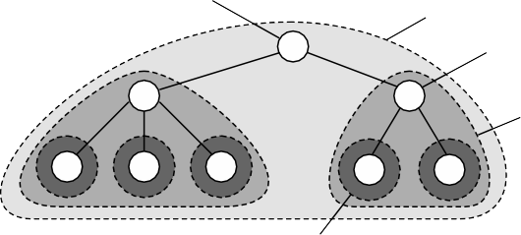
Hierarchical Location Services (HLS)
Naming: Flat naming Hierarchical approaches
Basic idea
Build a large-scale search tree for which the underlying network is divided into hierarchical domains. Each domain is represented by a separate directory node.
Principle
The root directory
node dir(T)
Top-level domain T
Directory node dir(S) of domain S
A subdomain S
of top-level domain T (S is contained in T)
A leaf domain, contained in S

Slide 25



Naming: Flat naming
Hierarchical approaches
HLS: Tree organization
Invariants
Address of entity E is stored in a leaf or intermediate node
Intermediate nodes contain a pointer to a child if and only if the subtree rooted at the child stores an address of the entity
The root knows about all entities
Storing information of an entity having two addresses in different leaf domains
Field with no data
Field for domain
dom(N) with pointer to N
Location record for E at node M
M
N
Location record with only one field,
containing an address
Domain D1
Domain D2

Slide 26


Naming: Flat naming
Hierarchical approaches
HLS: Lookup operation
Basic principles
Start lookup at local leaf node
Node knows about E ⇒ follow downward pointer, else go up
Upward lookup always stops at root
Looking up a location
Node knows
about E, so request is forwarded to child
Node has no record for E, so that request is forwarded to parent
M
Look-up request
Domain D

Slide 27



HLS: Insert operation
Naming: Flat naming Hierarchical approaches
(a) An insert request is forwarded to the first node that knows about entity E . (b) A chain of forwarding pointers to the leaf node is created
Node knows
Node has no record for E, so request is forwarded
to parent
about E, so request
is no longer forwarded
Node creates record and stores pointer
M
M
Node creates record and stores address
Domain D
Insert
request
(a)
(b)

Slide 28
Naming: Flat naming
Hierarchical approaches
Can an HLS scale?
Observation
A design flaw seems to be that the root node needs to keep track of all
identifiers ⇒ make a distinction between a logical design and its
physical implementation.
Notation
Assume there are a total of N physical hosts {H₁, H₂ , . . . , H_{N} }. Each host is capable of running one or more location servers.
D_{k} (A) denotes the domain at level k that contains address A; k = 0 denotes the root domain.
LS_{k} (E, A) denotes the unique location server in D_{k} (A)
responsible for keeping track of entity E .

Slide 29
Naming: Flat naming
Hierarchical approaches
Can an HLS scale?
Basic idea for scaling
Choose different physical servers for the logical name servers on a per-entity basis
(at root level, but also intermediate)
Implement a mapping of entities to physical servers such that the load of storing records will be distributed

Slide 30
Naming: Flat naming
Hierarchical approaches
Can an HLS scale?
Solution
D_{k} = {D_{k,1}, D_{k,2} , . . . , D_{k,Nk} } denotes the N_{k} domains at level k
Note: N₀ = |D₀| = 1.
For each level k , the set of hosts is partitioned into N_{k} subsets, with each host running a location server representing exactly one of the domains D_{k,i} from D_{k} .
Principle of distributing logical location servers
Tree for one specific entity Location server Host
Level 0
Level 1
Domain
Level 2
Level 3
H₁
H₂
H₃
H₄
H₅
H₆
H₇
H₈
H₉

Slide 31
Lingkup Bahasan
Sistem penamaan dalam sistem terdistribusi
Flat naming
Structured naming
Atribute-based naming
Kesimpulan

Slide 32






Name space
Naming: Structured naming Name spaces
Naming graph
A graph in which a leaf node represents a (named) entity. A directory node is an entity that refers to other nodes.
A general naming graph with a single root node
Data stored in n1 n2: "elke"
n3: "max" n4: "steen"
n0
home
keys
n1
"/keys"
^{n5} "/home/steen/keys"
elke
max
steen
keys
Leaf node
n2
n3
n4
mbox
"/home/steen/mbox"
Directory node
.procmail
Note
A directory node contains a table of (node identifier, edge label) pairs.

Slide 33
Naming: Structured naming
Name spaces
Name space
We can easily store all kinds of attributes in a node
Type of the entity
An identifier for that entity
Address of the entity’s location
Nicknames
...
Note
Directory nodes can also have attributes, besides just storing a directory table with (identifier, label) pairs.
24 / 46

Slide 34
Naming: Structured naming
Name resolution
Name resolution
Problem
To resolve a name we need a directory node. How do we actually find that (initial) node?
Closure mechanism: The mechanism to select the implicit context from which to start name resolution
www.distributed-systems.net: start at a DNS name server
/home/maarten/mbox: start at the local NFS file server (possible recursive search)
0031 20 598 7784: dial a phone number
77.167.55.6: route message to a specific IP address
Note
You cannot have an explicit closure mechanism – how would you start?
Closure mechanism
25 / 46

Slide 35
Name linking
Naming: Structured naming Name resolution
Hard link
What we have described so far as a path name: a name that is resolved by following a specific path in a naming graph from one node to another.
Soft link: Allow a node N to contain a name of another node
First resolve N’s name (leading to N)
Read the content of N, yielding name
Name resolution continues with name
Observations
The name resolution process determines that we read the content of a node, in particular, the name in the other node that we need to go to.
One way or the other, we know where and how to start name resolution given name
Linking and mounting
26 / 46

Slide 36






Naming: Structured naming
Name resolution
Name linking
The concept of a symbolic link explained in a naming graph
Data stored in n1 n2: "elke"
n3: "max" n4: "steen"
n0
home
keys
n1
n5 "/keys"
elke
max
steen
n2
n3
n4
Data stored in n6 "/keys"
.procmail
mbox
keys
n6 "/home/steen/keys"
Observation
Node n5 has only one name
Linking and mounting

Slide 37
Mounting
Naming: Structured naming Name resolution
Issue
Name resolution can also be used to merge different name spaces in a transparent way through mounting: associating a node identifier of another name space with a node in a current name space.
Terminology
Foreign name space: the name space that needs to be accessed
Mount point: the node in the current name space containing the node identifier of the foreign name space
Mounting point: the node in the foreign name space where to
continue name resolution
Mounting across a network
The name of an access protocol.
The name of the server.
The name of the mounting point in the foreign name space.
Linking and mounting

Slide 38


Mounting in distributed systems
Naming: Structured naming Name resolution
Mounting remote name spaces through a specific access protocol
Name server
Machine A
Name server for foreign name space
Machine B
remote
keys
home
^{vu} "nfs://flits
.cs.vu.nl/home/steen"
steen
mbox
Network
Reference to foreign name space
Linking and mounting

Slide 39
Name-space implementation
Naming: Structured naming The implementation of a name space
Basic issue
Distribute the name resolution process as well as name space management across multiple machines, by distributing nodes of the naming graph.
Distinguish three levels
Global level: Consists of the high-level directory nodes. Main aspect is that these directory nodes have to be jointly managed by different administrations
Administrational level: Contains mid-level directory nodes that can be grouped in such a way that each group can be assigned to a separate administration.
Managerial level: Consists of low-level directory nodes within a
single administration. Main issue is effectively mapping directory nodes to local name servers.
Name space distribution
30 / 46

Slide 40
Naming: Structured naming
The implementation of a name space
Name-space implementation
An example partitioning of the DNS name space, including network files
Global layer
gov mil org net
com edu
jp
us
nl
oracle
yale
acm
ieee ac
co
uva
vu
Adminis- trational
layer
eng
cs eng
jack
jill
keio
nec
cs
cs
csl
ftp www
ai
linda
pc24
robot
pub
Mana- gerial layer
globule
Zone
index.htm
Name space distribution

Slide 41
Name-space implementation
Naming: Structured naming The implementation of a name space
A comparison between name servers for implementing nodes in a name space
Item | Global | Administrational | Managerial
1 | Worldwide | Organization | Department
2 | Few | Many | Vast numbers
3 | Seconds | Milliseconds | Immediate
4 | Lazy | Immediate | Immediate
5 | Many | None or few | None
6 | Yes | Yes | Sometimes
1: Geographical scale 2: # Nodes 3: Responsiveness |  | 4: Update propagation 5: # Replicas 6: Client-side caching?
Name space distribution

Slide 42


Iterative name resolution
Naming: Structured naming The implementation of a name space
Principle
resolve(dir, [name₁,..., name_{K} ]) sent to Server₀ responsible for
dir
Server₀ resolves resolve(dir, name₁) → dir₁, returning the identification (address) of Server₁, which stores dir₁.
Client sends resolve(dir₁, [name₂ , ..., name_{K} ]) to Server₁, etc.
Root name server
nl
Name server nl node
vu
Name server vu node
cs
Name server cs node
Client's name resolver | 1. [nl,vu,cs,ftp]
 | #[nl], [vu,cs,ftp] [vu,cs,ftp]
 | #[vu], [cs,ftp] [cs,ftp]
 | 6. #[cs], [ftp] 7. [ftp]
 | 8. #[ftp]
[nl,vu,cs,ftp]
#[nl,vu,cs,ftp]
ftp
Nodes are managed by the same server
Implementation of name resolution

Slide 43
Recursive name resolution
Naming: Structured naming The implementation of a name space
Principle
resolve(dir, [name₁,..., name_{K} ]) sent to Server₀ responsible for
dir
Server₀ resolves resolve(dir, name₁) → dir₁, and sends
resolve(dir₁, [name₂ , ..., name_{K} ]) to Server₁, which stores dir₁.
Server₀ waits for result from Server₁, and returns it to client.
[nl,vu,cs,ftp]
[vu,cs,ftp]
Client's name resolver |  | Root name server
 | 8. #[nl,vu,cs,ftp]
 | 7. #[vu,cs,ftp] ^{Name server} nl node 6. #[cs,ftp] Name server vu node _{5. #[ftp]} Name server cs node
3. [cs,ftp]
4. [ftp]
[nl,vu,cs,ftp]
#[nl,vu,cs,ftp]
Implementation of name resolution

Slide 44
Naming: Structured naming
The implementation of a name space
Caching in recursive name resolution
Recursive name resolution of [nl , vu, cs,ftp]
Server for node | Should resolve | Looks up | Passes to child | Receives and caches | Returns to requester
cs | [ftp] | #[ftp] | — | — | #[ftp]
vu | [cs, ftp] | #[cs] | [ftp] | #[ftp] | #[cs] #[cs, ftp]
nl | [vu, cs, ftp] | #[vu] | [cs, ftp] | #[cs] #[cs, ftp] | #[vu] #[vu, cs] #[vu, cs, ftp]
root | [nl, vu, cs, ftp] | #[nl ] | [vu, cs, ftp] | #[vu] #[vu, cs] #[vu, cs, ftp] | #[nl ] #[nl, vu] #[nl, vu, cs] #[nl, vu, cs, ftp
]
Implementation of name resolution

Slide 45
Naming: Structured naming
The implementation of a name space
Scalability issues
Size scalability
We need to ensure that servers can handle a large number of requests per time unit ⇒ high-level servers are in big trouble.
Solution
Assume (at least at global and administrational level) that content of nodes hardly ever changes. We can then apply extensive replication by mapping nodes to multiple servers, and start name resolution at the nearest server.
Observation
An important attribute of many nodes is the address where the represented entity can be contacted. Replicating nodes makes large-scale traditional name servers unsuitable for locating mobile entities.
Implementation of name resolution
36 / 46

Slide 46
Scalability issues
Naming: Structured naming The implementation of a name space
We need to ensure that the name resolution process scales across large geographical distances
Recursive name resolution
R1
I1
Name server
nl node
R2
Client
I2
Name server
vu node
I3
R3
Iterative name resolution
Name server
cs node
Long-distance communication
Problem
By mapping nodes to servers that can be located anywhere, we
introduce an implicit location dependency.
Implementation of name resolution
37 / 46

Slide 47
Naming: Structured naming
Example: The Domain Name System
DNS
Essence
Hierarchically organized name space with each node having
exactly one incoming edge ⇒ edge label = node label. domain: a subtree
domain name: a path name to a domain’s root node.
Information in a node
Type | Refers to | Description
SOA | Zone | Holds info on the represented zone
A | Host | IP addr. of host this node represents
MX | Domain | Mail server to handle mail for this node
SRV | Domain | Server handling a specific service
NS | Zone | Name server for the represented zone
CNAME | Node | Symbolic link
PTR | Host | Canonical name of a host
HINFO | Host | Info on this host
TXT | Any kind | Any info considered useful
The DNS name space
38 / 46

Slide 48
Lingkup Bahasan
Sistem penamaan dalam sistem terdistribusi
Flat naming
Structured naming
Atribute-based naming
Kesimpulan

Slide 49
Naming: Attribute-based naming
Directory services
Attribute-based naming
Observation
In many cases, it is much more convenient to name, and look up
entities by means of their attributes ⇒ traditional directory services
(aka yellow pages).
Problem
Lookup operations can be extremely expensive, as they require to
match requested attribute values, against actual attribute values ⇒
inspect all entities (in principle).
39 / 46

Slide 50
Implementing directory services
Naming: Attribute-based naming Hierarchical implementations: LDAP
Solution for scalable searching
Implement basic directory service as database, and combine with traditional structured naming system.
Lightweight Directory Access Protocol (LDAP)
Each directory entry consists of (attribute, value) pairs, and is uniquely named to ease lookups.
Attribute | Abbr. | Value
Country | C | NL
Locality | L | Amsterdam
Organization | O | VU University
OrganizationalUnit | OU | Computer Science
CommonName | CN | Main server
Mail Servers | – | 137.37.20.3, 130.37.24.6, 137.37.20.10
FTP Server | – | 130.37.20.20
WWW Server | – | 130.37.20.20

Slide 51
LDAP
Naming: Attribute-based naming Hierarchical implementations: LDAP
Essence
Directory Information Base: collection of all directory entries in an LDAP service.
Each record is uniquely named as a sequence of naming attributes (called Relative Distinguished Name), so that it can be looked up.
Directory Information Tree: the naming graph of an LDAP
directory service; each node represents a directory entry.
Part of a directory information tree
C = NL
O = VU University
OU = Computer Science
CN = Main server N
HostName = star
HostName = zephyr

Slide 52
Naming: Attribute-based naming
Hierarchical implementations: LDAP
LDAP
Two directory entries having HostName as RDN
Attribute | Value | Attribute | Value
Locality | Amsterdam | Locality | Amsterdam
Organization | VU University | Organization | VU University
OrganizationalUnit | Computer Science | OrganizationalUnit | Computer Science
CommonName | Main server | CommonName | Main server
HostName | star | HostName | zephyr
HostAddress | 192.31.231.42 | HostAddress | 137 .37 .20.10
Result of search(‘‘(C=NL)(O=VU University)(OU=*)(CN=Main server)’’)

Slide 53
Naming: Attribute-based naming
Decentralized implementations
Distributed index
Basic idea
Assume a set of attributes {a¹,..., a^{N} }
Each attribute a^{k} takes values from a set R^{k}
►
►
k
k k
k
For each attribute a associate a set S = {
S , . . . , S } of n
k
1 nk
servers
k k k k
k
Global mapping F : F (a , v ) = S with S ∈ S and v ∈ R
j
j
Observation
If L(a^{k} , v ) is set of keys returned by F (a^{k} , v ), then a query can be formulated as a logical expression, e.g.,
1 1 2 2 3 3
F (a , v ) ∧F (a , v ) ∨F (a , v )
which can be processed by the client by constructing the set
L(a¹, v ¹) ∩L(a² , v ² ) ∪L(a³ , v ³ )
Using a distributed index

Slide 54
Naming: Attribute-based naming
Decentralized implementations
Drawbacks of distributed index
Quite a few
A query involving k attributes requires contacting k servers
Imagine looking up “lastName = Smith ∧firstName = Pheriby ”: the client may need to process many files as there are so many people named “Smith.”
No (easy) support for range queries, such as “price = [1000 − 2500].”
Using a distributed index

Slide 55

Alternative: map all attributes to 1 dimension and then index
Naming: Attribute-based naming Decentralized implementations
Space-filling curves: principle
Map the N-dimensional space covered by the N attributes
{a¹,..., a^{N} } into a single dimension
Hashing values in order to distribute the 1-dimensional space among index servers.
Hilbert space-filling curve of (a) order 1, and (b) order 4
1
Index 1
Index 2
14/16
12/16
10/16
8/16
6/16
4/16
Values attribute #2
Values attribute #2
Index 0
Index 3
2/16
0/16
0
1
0 2 4 6 8 10 12 14
16 16 16 16 16 16 16 16
Values attribute #1
(a)
Values attribute #1
(b)
Space-filling curves

Slide 56
Naming: Attribute-based naming
Decentralized implementations
Space-filling curve
Once the curve has been drawn
Consider the two-dimensional case
a Hilbert curve of order k connects 2^{2k} subsquares ⇒ has 2^{2k} indices.
A range query corresponds to a rectangle R in the 2-dimensional case
R intersects with a number of subsquares, each one
corresponding to an index ⇒ we now have a series of indices associated with R.
Getting to the entities
Each index is to be mapped to a server, who keeps a reference to the associated entity. One possible solution: use a DHT.
Space-filling curves

Slide 57
Universitas Pertahanan RI
Fakultas Sains dan Teknologi Pertahanan

